Slide 1
Module 13 System and User Security

Slide 2
Exam Objective 5.1 Basic Security and Identifying User Types
Objective Summary
Working with Root and Standard Users
System Users

Slide 3
User accounts and passwords

Slide 4
User accounts
Files in the /etc directory contain account data.
The /etc/passwd file defines some of the account information for user accounts.

Slide 5
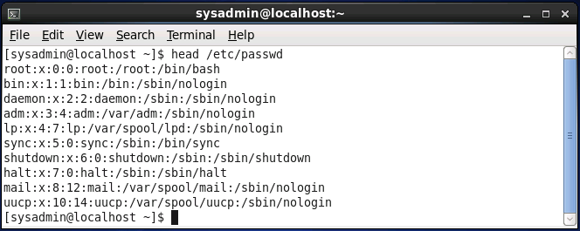
The /etc/passwd file
Each line of the /etc/passwd file relates to a user account.
Each line is separated into fields by colon characters. The fields from left to right are as follows:
name:password placeholder:user id:primary group id:comment:home directory:shell

Slide 6
The /etc/passwd file
Field | Example | Description
name | root | This is the name of the account.
password placeholder | x | The x in the password placeholder field indicates to the system that the password is not stored here, but rather in the /etc/shadow file.
user id | 0 | Each account is assigned a user ID (UID).
primary group id | 0 | When a user creates a file, the file is owned by a group id (GID), the user's primary GID.
comment | root | This field can contain any information about the user, including their real (full) name and other useful information..
home directory | /root | This field defines the location of the user's home directory.
shell | /bin/bash | This is the location of the user's login shell.

Slide 7
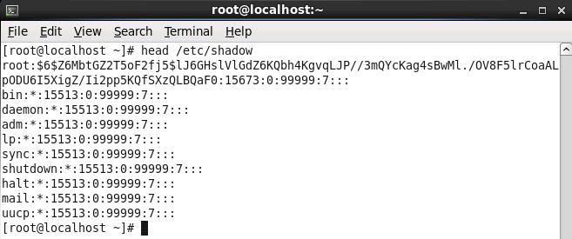
The /etc/shadow file
Contains account information related to the user's password.
The fields of the /etc/shadow file are:
name:password:lastchange:min:max:warn:inactive:expire:reserved

Slide 8
The /etc/shadow file
Field | Example | Description
name | sysadmin | This is the name of the account, which matches the account name in the /etc/passwd file.
password | $6$.........rl1 | The password field contains the encrypted password for the account.
last change | 15020 | This field contains a number that represents the last time the password was changed.
min | 5 | The password can't be changed again for the specified number of days.
max | 30 | This field is used to force users to change their passwords on a regular basis
warn | 7 | If the max field is set, the warn field indicates that the user would be "warned" when the max timeframe is approaching.
inactive | 60 | The inactive field provides the user with a "grace" period in which their password can be changed.
expire | 15050 | This field represents the number of days from January 1, 1970 and the day the account will "expire".

Slide 9
Viewing Account Information

Slide 10
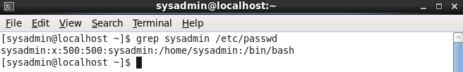
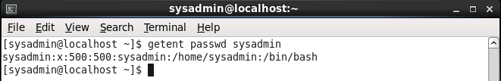
Viewing account information
To see the account information for the user name named "sysadmin", use the grep sysadmin /etc/passwd command:
Another technique is the getent command:

Slide 11
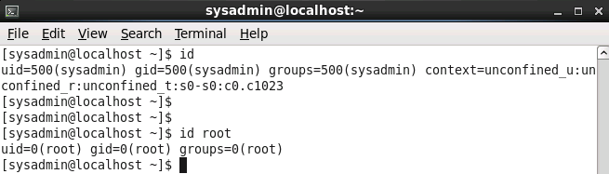
Viewing login information
To verify your identity you can execute the id command:

Slide 12
System Accounts

Slide 13
System accounts
System accounts are designed to provide accounts for services that are running on the system.
Have UIDs between 1-499
Have non-login shells in /etc/passwd
Have * in password field of /etc/shadow
Most are critical for system operation.
Only delete a system account when 100% certain it is not needed.

Slide 14
System Groups

Slide 15
Group accounts
Each user can be a member of one or more groups.
The /etc/passwd file defines the primary group membership for a user.
Supplemental group membership is defined in the /etc/group file.
Either the grep or getent commands can be used to display group information.

Slide 16
The /etc/group file
Each group is defined by this file.
A colon delimited file with the following fields:
group_name:password_placeholder:GID:user_list
Field | Example | Description
group_name | mail | This field contains the group name.
password_placeholder | x | The "x" in this field is used to indicate that the password is stored in the /etc/gshadow file.
GID | 12 | Each group is associated with a unique Group ID (GID) which is placed in this field.
user_list | mail,postfix | This last field is used to indicate who is a member of the group.

Slide 17
Changing groups
Create a file that owned by one of your secondary groups by using:
newgrp group_name
Opens a new shell with new primary group.
Use id command to verify new primary group.
Use exit command to return to previous shell.
May be disabled due to group passwords.

Slide 18
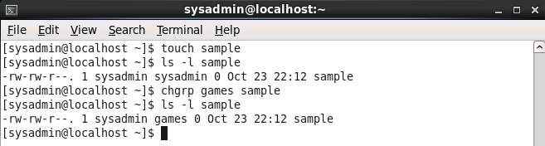
Changing the group ownership of an existing file
Change group ownership of existing file by using:
chgrp group_name file_name
Only allowed to change group ownership of files you own.
Must also be a member of the new group.

Slide 19
Working with root

Slide 20
Logging in as root
Logging in directly to root account poses a security risk.
Instead, use the su or sudo command.

Slide 21
Using the su command
The su command opens a new shell as a different user. (UID changes, but doesn’t assume all env.)
Example: su user1
To sign in as if the user had executed a login session
Example: su - user1
Often used to run commands as the root user.
Use the –l option for a full login shell.
The root user is the default user.
Use exit command to return to original shell.

Slide 22
sudo Command

Slide 23
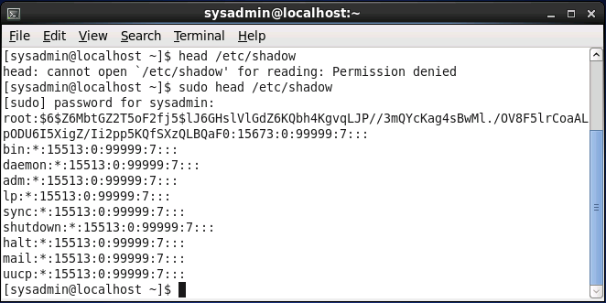
Using the sudo command
The sudo command allows you to execute a single command as a different user.
Must be set up by installation program or manually after install.
Prompts user for their own password.

Slide 24
Setting up the sudo command
Configuration is in the /etc/sudoers file.
Modify this file with the visudo command.
Uses vi/vim editors by default.
Use the following to modify default editor:
export EDITOR=gedit
Entry to provide user bob rights to run commands as root user:
Bob ALL=(ALL) ALL

Slide 25
who and w Command

Slide 26
Using the who command
Displays a list of users who are currently logged in:
[sysadmin@localhost ~]$ who
root tty2 2013-10-11 10:00
sysadmin tty1 2013-10-11 09:58 (:0)
sysadmin pts/0 2013-10-11 09:59 (:0.0)
sysadmin pts/1 2013-10-11 10:00 (example.com)
Column | Example | Description
username | root | Name of the user who is logged in.
terminal | tty2 | This column indicates which terminal window the user is working in.
date | 2013-10-11 10:00 (example.com) | This indicates when the user logged in.

Slide 27
Using the w command
Displays detailed user and system information:
[sysadmin@localhost ~]$ w
10:44:03 up 50 min, 4 users, load average: 0.78, 0.44, 0.19
USER TTY FROM LOGIN@ IDLE JCPU PCPU WHAT
root tty2 - 10:00 43:44 0.01s 0.01s -bash
sysadmin tty1 :0 09:58 50:02 5.68s 0.16s id
sysadmin pts/0 :0.0 09:59 0.00s 0.14s 0.13s who
sysadmin pts/1 example.com 10:00 0.00s 0.03s 0.01s w

Slide 28
Using the w command
Column | Example | Description
USER | root | This column indicates the name of the user who is logged in.
TTY | tty2 | This column indicates which terminal window the user is working in.
FROM | example.com | Where the user logged in from.
LOGIN@ | 10:00 | When the user logged in.
IDLE | 43:44 | How long the user has been idle since the last command they ran.
JCPU | 0.01s | The total cpu time (s=seconds) used by all processes (programs) run since login.
PCPU | 0.01s | The total cpu time for the current process.
WHAT | -bash | The current process that the user is running.

